Slide 1
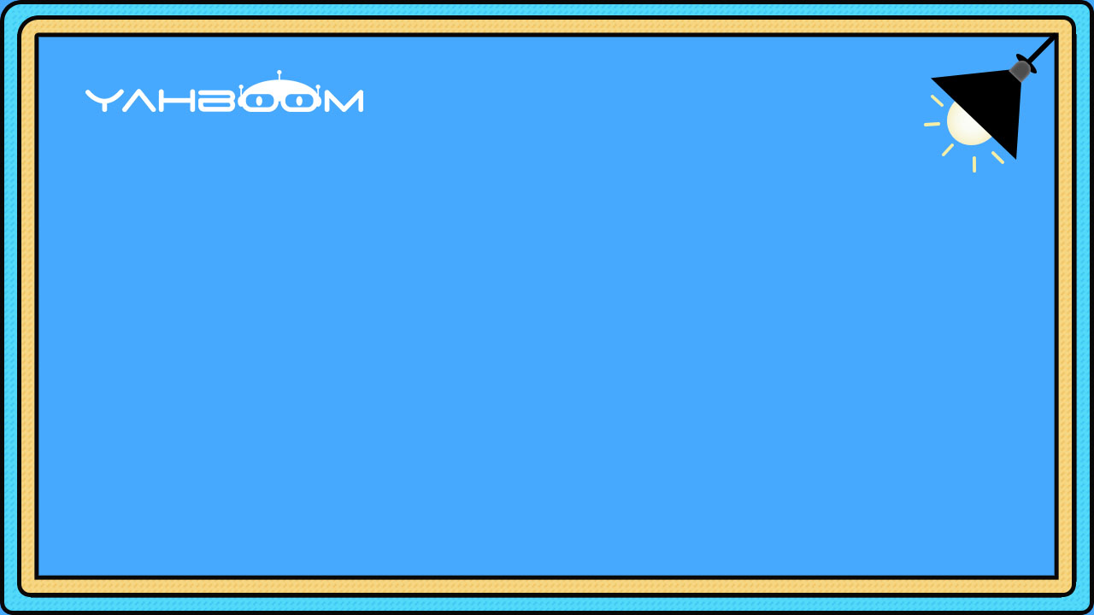

micro:bit programming tutorial
Lesson 14
micro:bit basic lesson 14“Stopwatch”
Yahboom micro:bit tutorial

Slide 2
micro:bit programming tutorial
Part1
Part 2
Part3
Part 4
Part 5
Learning goals
Preparation
Search for blocks
Combine blocks
Have a try
Yahboom micro:bit tutorial

Slide 3
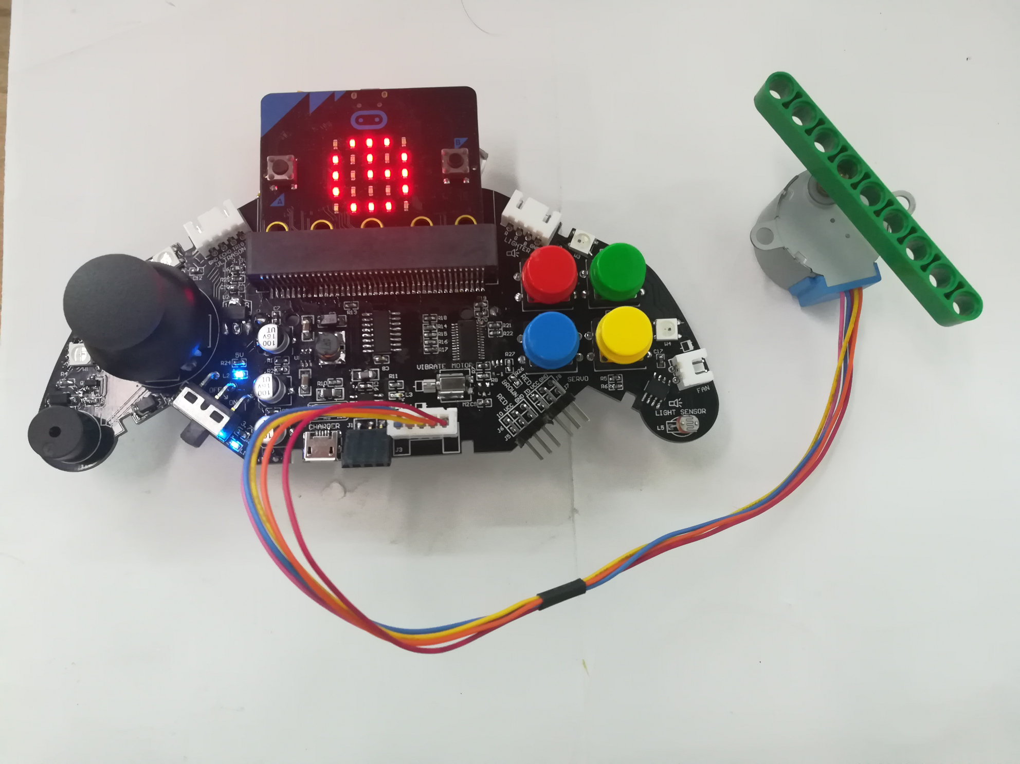
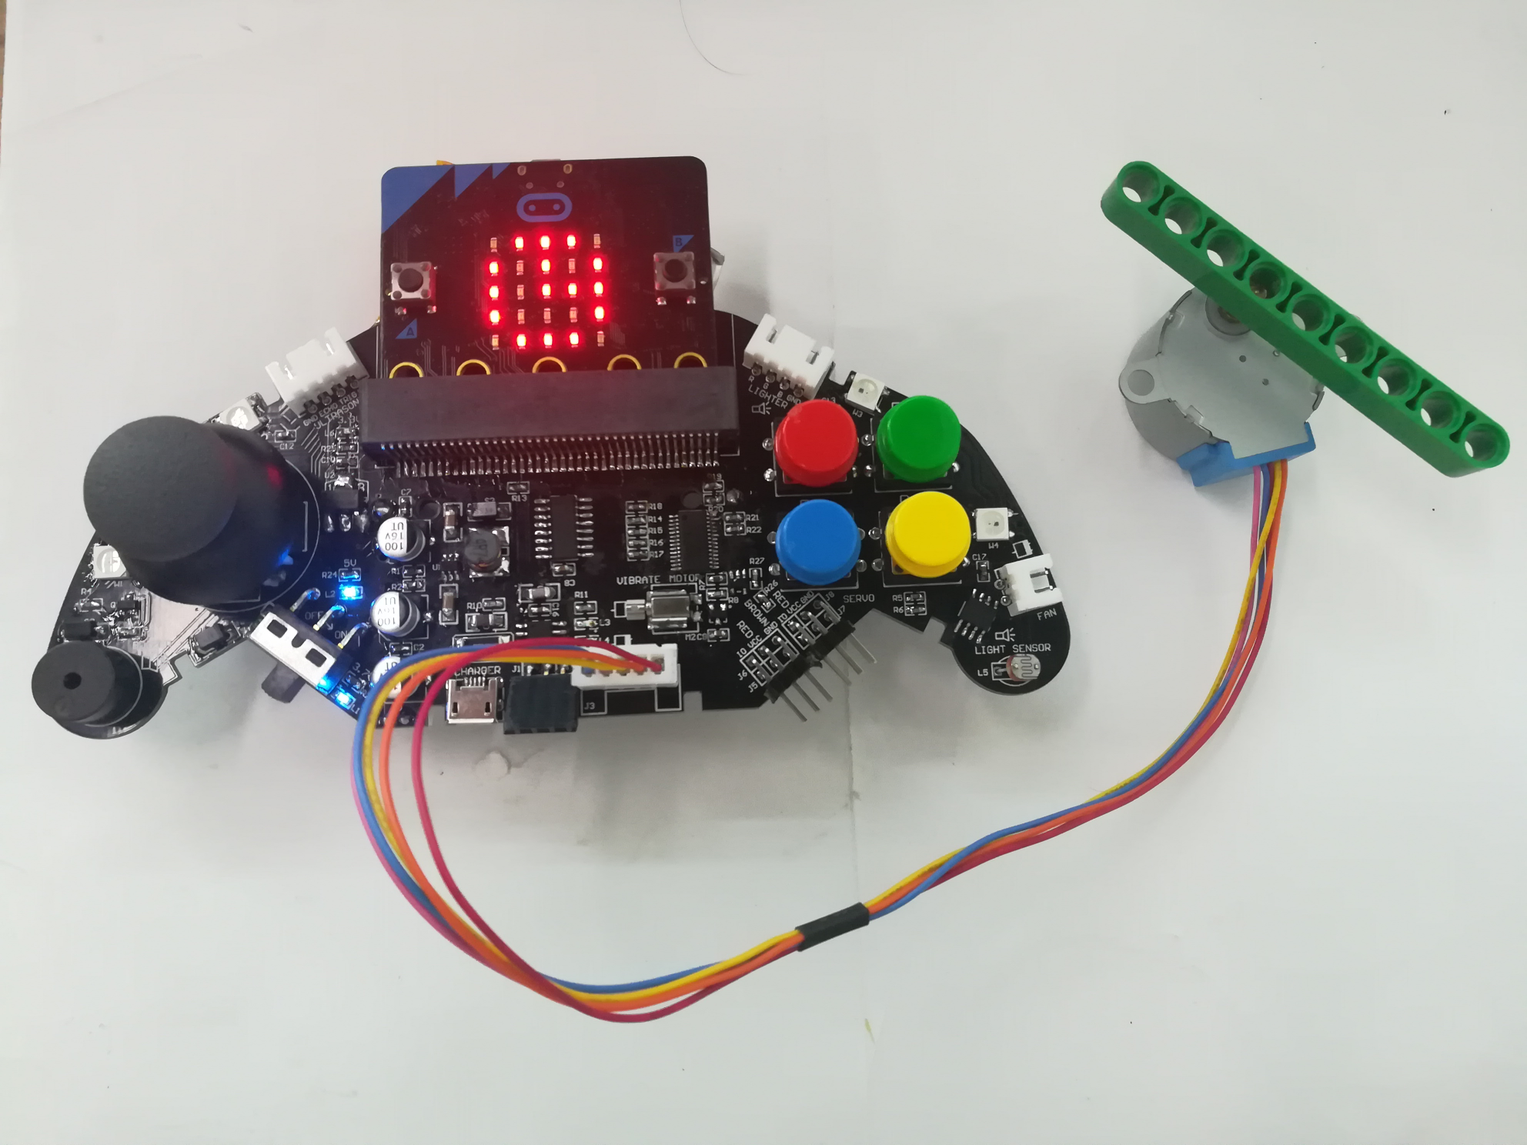
micro:bit programming tutorial
Part1
In this experiment, a stepping motor is added, and the stepping motor rotates clockwise to form a stopwatch, and a clock graphic is displayed on the LED screen. After pressing the red button, the stopwatch starts to rotate, and when the green button is pressed, it stops rotating.
Yahboom micro:bit tutorial

Slide 4
micro:bit programming tutorial
Part2
Hardware：
● 1 X micro:bit Game Handle
● 1 X Micro USB Cable
Yahboom micro:bit tutorial

Slide 5
micro:bit programming tutorial
Two programming methods
Part2
1.Online: Connect Micro:bit to the computer via USB cable, and the computer will pop up a U disk and click the URL in the U disk to enter the programming interface.Enter this URL https://github.com/yahboomtechnology/ghbitlib to get the package named GHBit.
2.offline：Open micro:bit offline programming software and add GHBit package.Click on "Advanced" and select "Add Package".Enter this URL https://github.com/yahboomtechnology/ghbitlib to get the package named GHBit.
Note: If you already have a GHBit package, you don't need to add it repeatedly.
Yahboom micro:bit tutorial

Slide 6
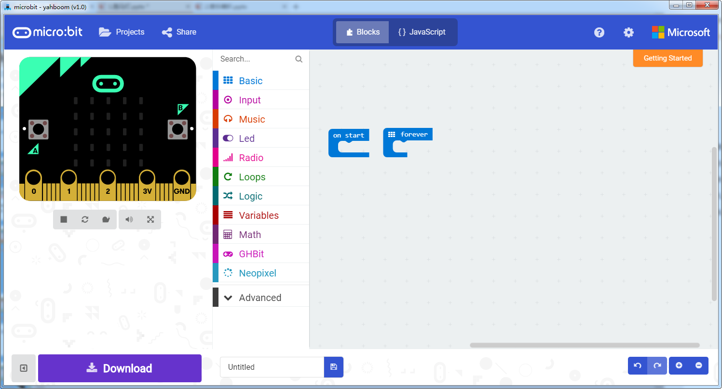
micro:bit programming tutorial
Programming interface
Part3
Yahboom micro:bit tutorial

Slide 7
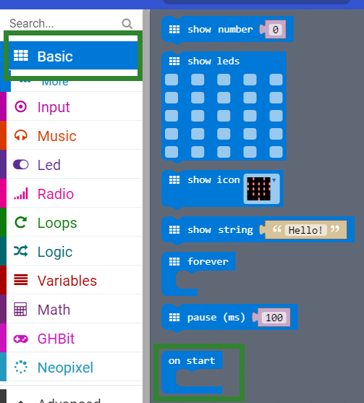
micro:bit programming tutorial
Part3
Start programming
The “on start” building block means that when the micro:bi Game Handle is turned on, the blocks in “on start” start executing and execute only once.
Yahboom micro:bit tutorial

Slide 8
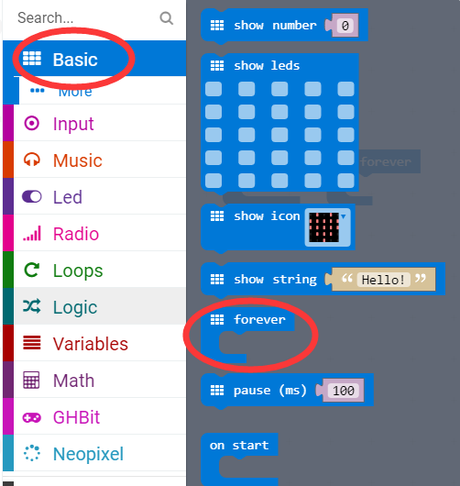
micro:bit programming tutorial
Part3
The “forever” building block means that when the micro:bi Game Handle is turned on, the blocks in “forever” are repeatedly executed.
Yahboom micro:bit tutorial

Slide 9
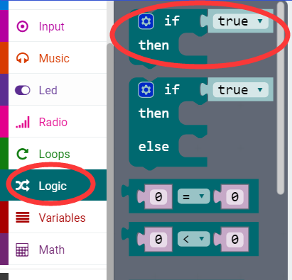
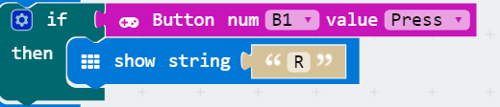
micro:bit programming tutorial
Part3
If a value is true, then do some statements.
For example: If the B1 button of the handle is pressed, the dot matrix display character R is executed. If the B1 button is not pressed, it will not be executed.
Yahboom micro:bit tutorial

Slide 10
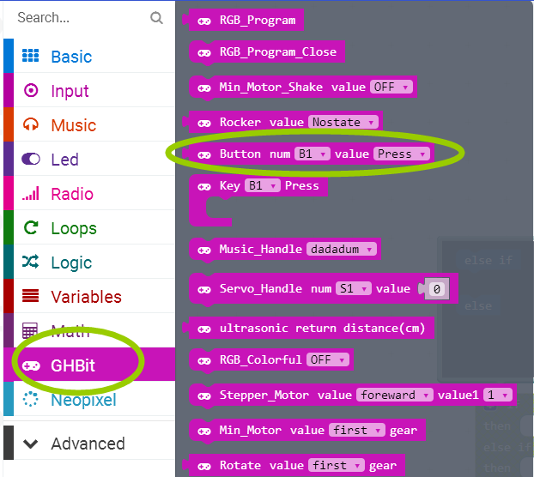
micro:bit programming tutorial
Part3
This is a building block about the keys. You can choose different keys to indicate that when this button is pressed, this building block can be combined with the "if then" building block.
Yahboom micro:bit tutorial

Slide 11
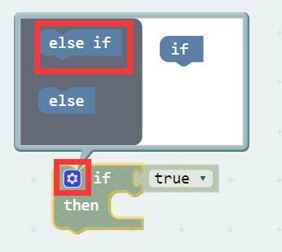
micro:bit programming tutorial
Part3
When there are many choices, you can click on the pinion above. Drag the "else if" on the left to the bottom of the "if" on the right, and click on the pinion again.
Yahboom micro:bit tutorial

Slide 12
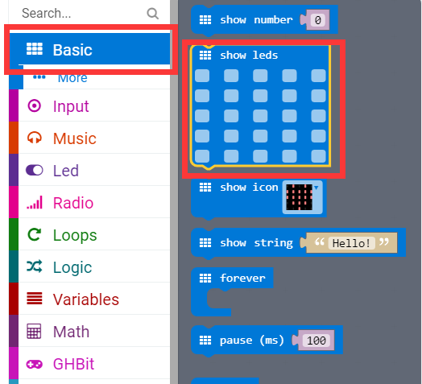
micro:bit programming tutorial
Part3
Draws an image on the LED screen.
Yahboom micro:bit tutorial

Slide 13
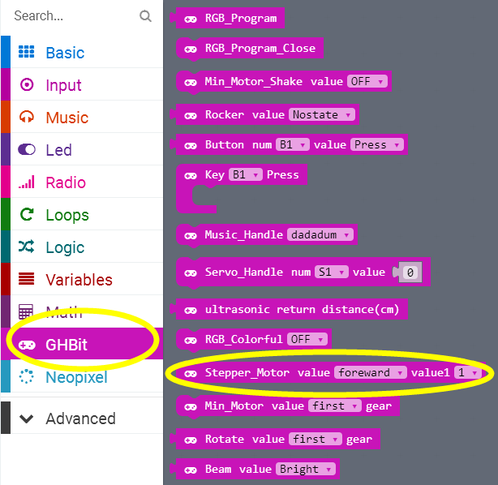
micro:bit programming tutorial
Part3
This is a stepper motor block that allows you to choose the direction and speed of rotation.
Yahboom micro:bit tutorial

Slide 14
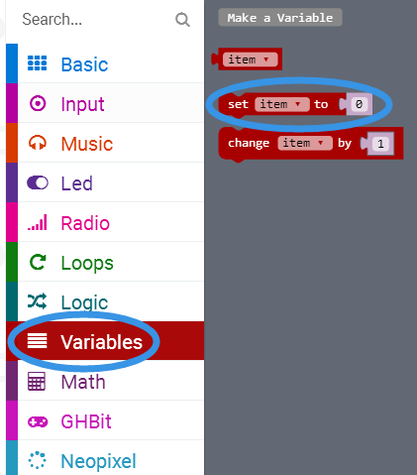
micro:bit programming tutorial
Part3
Sets this variable be equal to the input.
Yahboom micro:bit tutorial

Slide 15
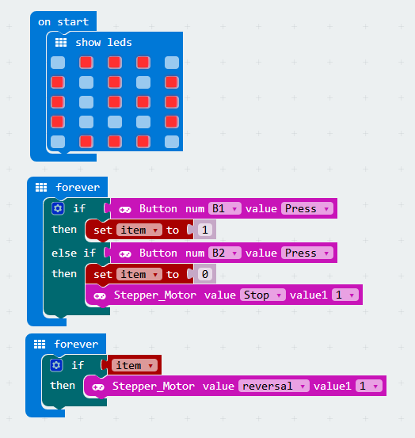
micro:bit programming tutorial
Part4
This is the complete building block for this course, let's download it to the micro:bit Game Handle.
Yahboom micro:bit tutorial

Slide 16
micro:bit programming tutorial
Part5
Do you learn the course today?
If you learn to do it, give yourself a top quack.
Now give you a homework assignment.
Modify the program to rotate the stepper motor counterclockwise
Start your little brain. Try it.
Yahboom micro:bit tutorial

Slide 17
micro:bit programming tutorial
micro:bit
Thanks for watching！
Yahboom
Yahboom micro:bit tutorial

